Slide 1

Swank K-12 Streaming:
Teacher Guide

Slide 2
Single Sign On
Access your Swank K-12 Streaming portal at the URL provided by your administrator.
If your school is configured for single sign on, you will automatically be taken to your school’s network log in. Log in using your school network credentials and you will be granted access to the streaming platform.

Slide 3
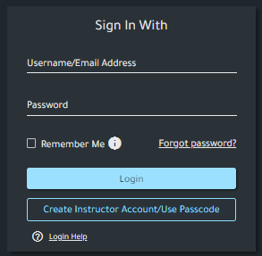
Username/Password
If you are not automatically routed to your school’s network log in, you can enter the username and password provided by your streaming administrator.
If you have not been provided a username and password, please refer to the following page for help with creating an account.

Slide 4
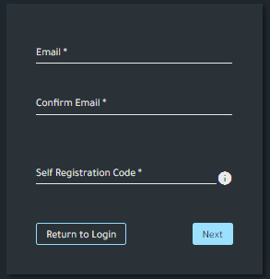
Creating Your Account:
To create an account for the first time, select
‘Create Instructor Account/Use Passcode.’
Your account admin will provide you with a unique passcode which can be used to register your school email. Once you’ve completed your account profile, a verification email will be sent to your inbox. After you’ve verified your school email, you will be granted access to the Swank K-12 Streaming library of films.

Slide 5
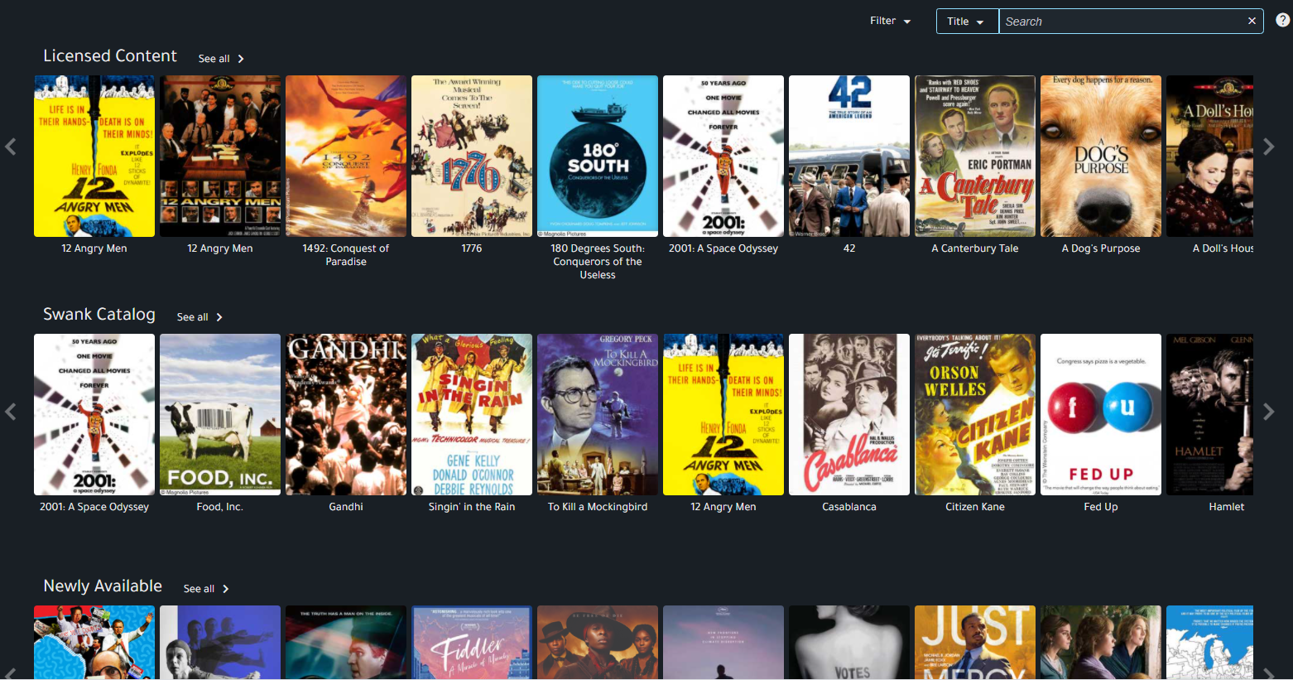
Browsing Movies
Licensed Content:
Access all of the films currently licensed
and immediately available at your school.
Swank Catalog:
Browse the entire Swank library of films available for either immediate viewing or upon request as indicated.
Newly Available:
Highlights new release films or new rights that we have acquired that are now available upon request.
Content Spotlight:
Lists films that are currently trending from other schools related to either current topics or specific times of year.

Slide 6
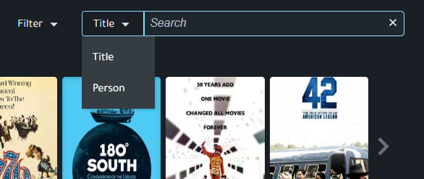
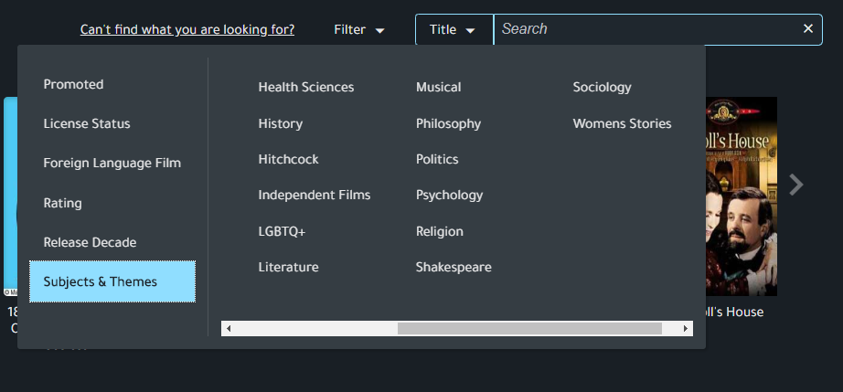
Searching Movies
Search by either movie title or person (actor/director)
Further narrow your search by filtering by items such as:
Language
Rating
Release Date
Subjects and Themes

Slide 7
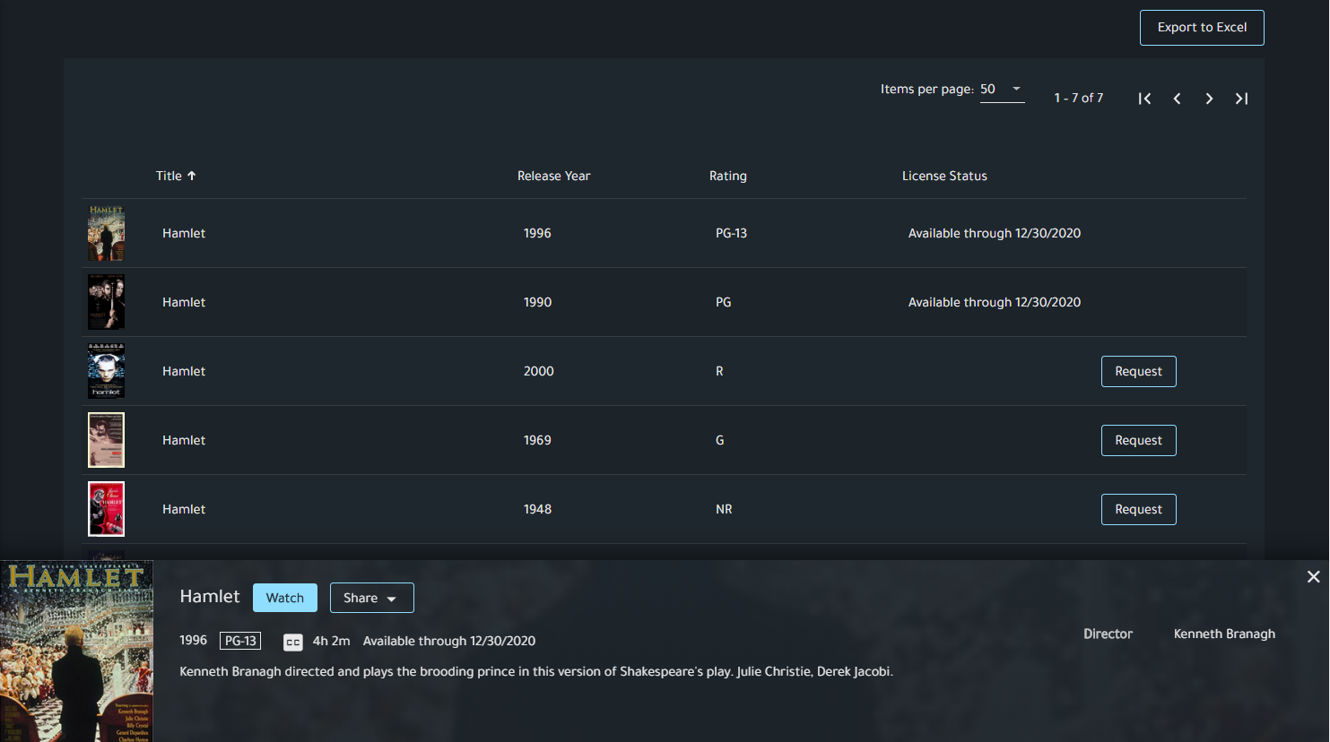
Search Results
Available through:
This indicates that this film is currently available for immediate playback through the date provided.
Request:
This film is available in our library but not currently available for immediate playback by your school. You may request that this film be added to your school’s library of available titles.

Slide 8
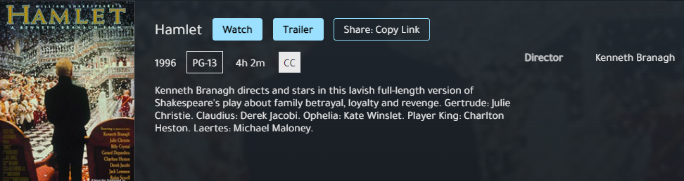
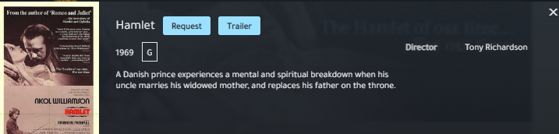
Search Results
Title previews will also indicate your ability to either Watch/Share a film with your class or Request access.

Slide 9
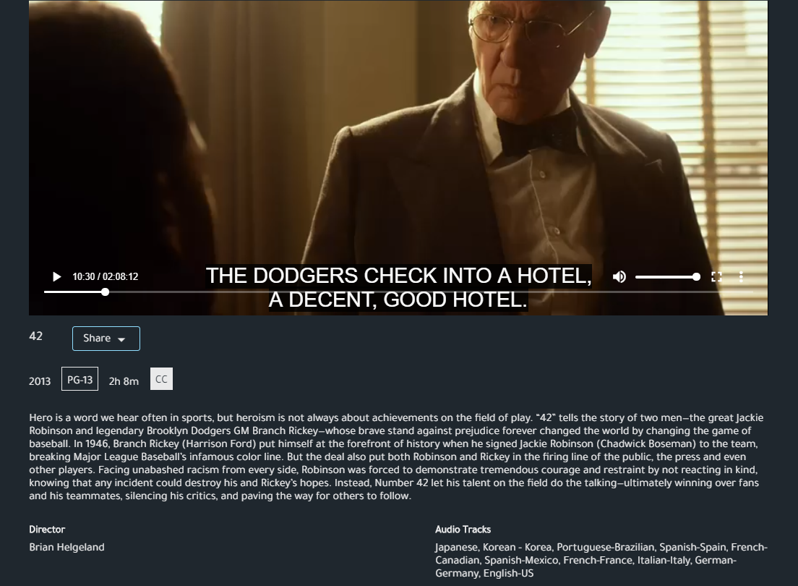
Playing Movies
Use the seek bar to jump to specific parts of a film.
The three dot menu icon will give you any additional language options available for a movie as well as Closed Captioning (English Subtitles).
Tip: Not seeing languages you need for a movie? Let us know as we might be able to secure them for you.
Click on the box next to volume on the bottom right to switch to full screen.

Slide 10
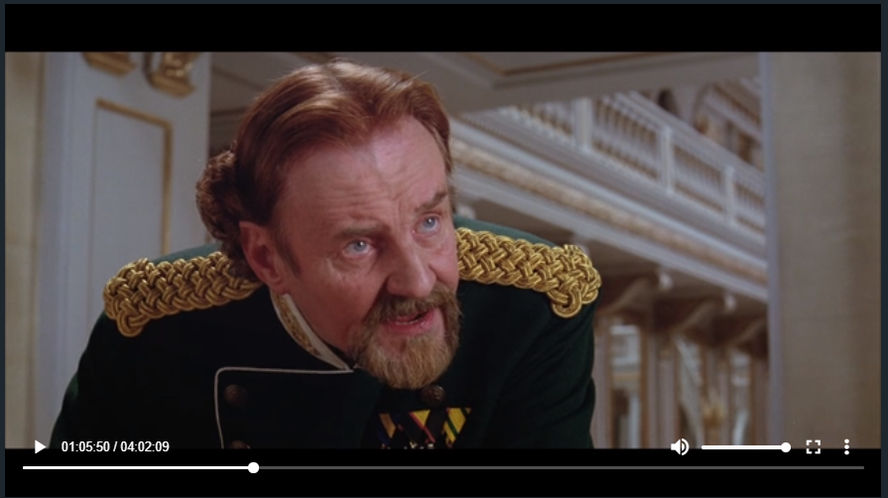
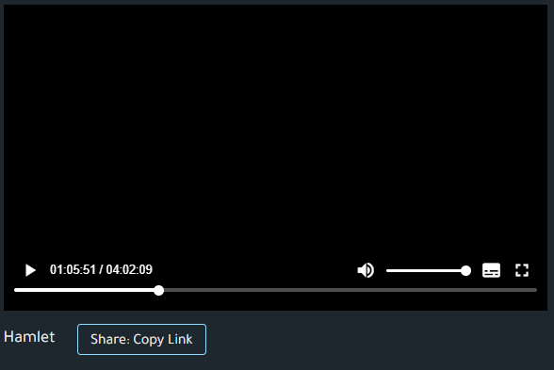
Assigning Movies
To share a currently available film with students, select Share: Copy Link on the movie’s watch page or preview page.
This will copy the full URL to the film, which enables access via any sharing option such as email, course syllabus, and Learning Management Systems.
Your school’s portal admin will provide additional information on how students will authenticate.

Slide 11
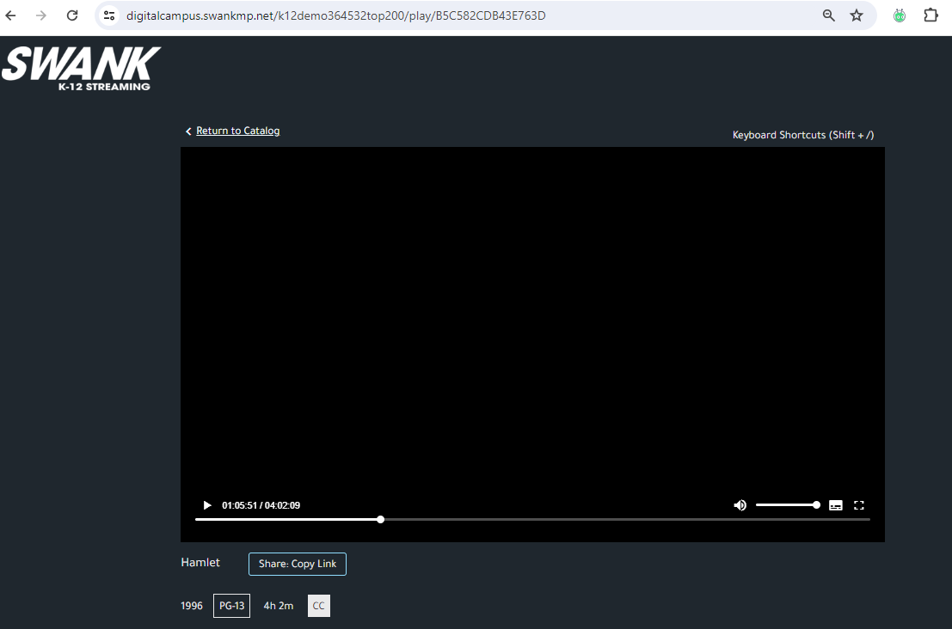
Assigning Movies
It is important to note that students DO NOT have the ability to see the entire library of films as you do. Students will only see films they have been assigned by providing them with the Share: Copy Link.
Providing students the main page navigation URL will result in them receiving an error message.

Slide 12
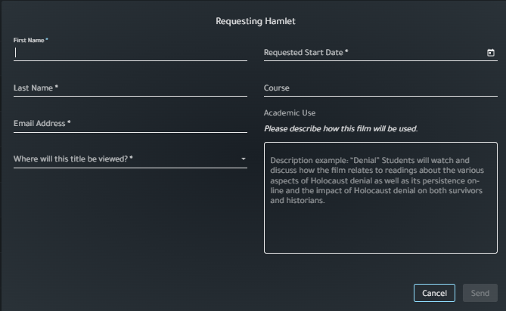
Requesting Movies
Need another title?
Aside from the movies available in your streaming library, your school may request additional titles per year.
After performing any search, films identified with a “Request” button are those not currently licensed for your school.
You can click “Request” and fill out the form as shown here, and the information will be sent to your school administrator for review.
Note: Once approved by your admin, requested films are typically available in your streaming library within 2 business days and will remain available through the duration of your school's Swank streaming contract.

