Slide 1


Swank Educational Streaming:
Admin Guide

Slide 2

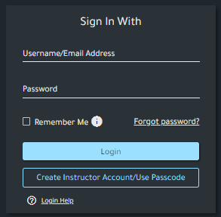
Admin Username/Password
Swank will provide you with a local username and password to access your admin portal.
Note: You are able to customize your username and/or password by clicking Profile on the menu once signed in

Slide 3
Management of Teacher Self Registration
Swank’s Passcode Registration allows for quick implementation and easy admin management overtime.
In order to self register, your teachers will select Create Instructor Account/Use Passcode and will need:
  Portal specific registration code
  District email address
Annual Admin Maintenance Required​
Teacher registration codes expire after one year. You’ll need to create a new code each school year so new users can create accounts without interruption. To create a new registration code:
Select Authentication in the left-hand menu of your admin dashboard
Under Instructor Self Registration, click Create New Registration Code
Toggle Unlimited Uses, then click Create
Distribute new registration code to any new teachers

Slide 4
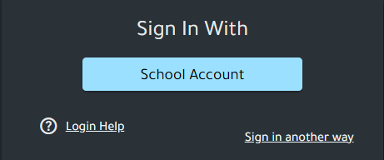
Single Sign-On
When Single Sign-On is enabled, teachers will sign in using their school-issued network credentials through the district authentication screen.
*Please note, your original local admin account created by the Swank Team can be used by selecting ‘Sign in another way.’
Interested in SSO?
If your district technology team is interested in configuring SSO, contact Swank Support for technical requirements and setup instructions.

Slide 5
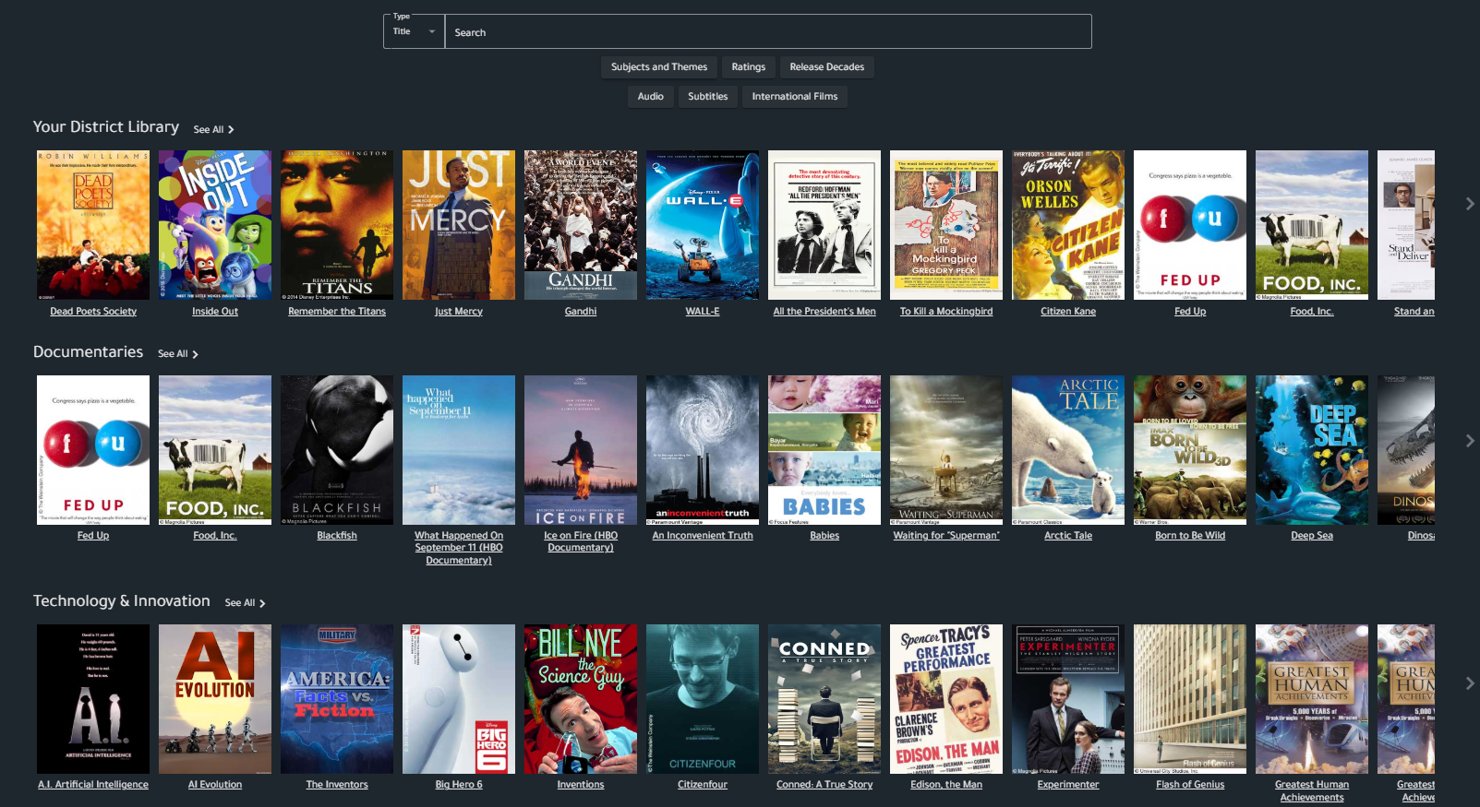
Search & Filter Movies
Search by:
Movie Title
Actor
Director
Filter Your Results By:
Language
Rating
Release Date
Subjects & Themes

Slide 6
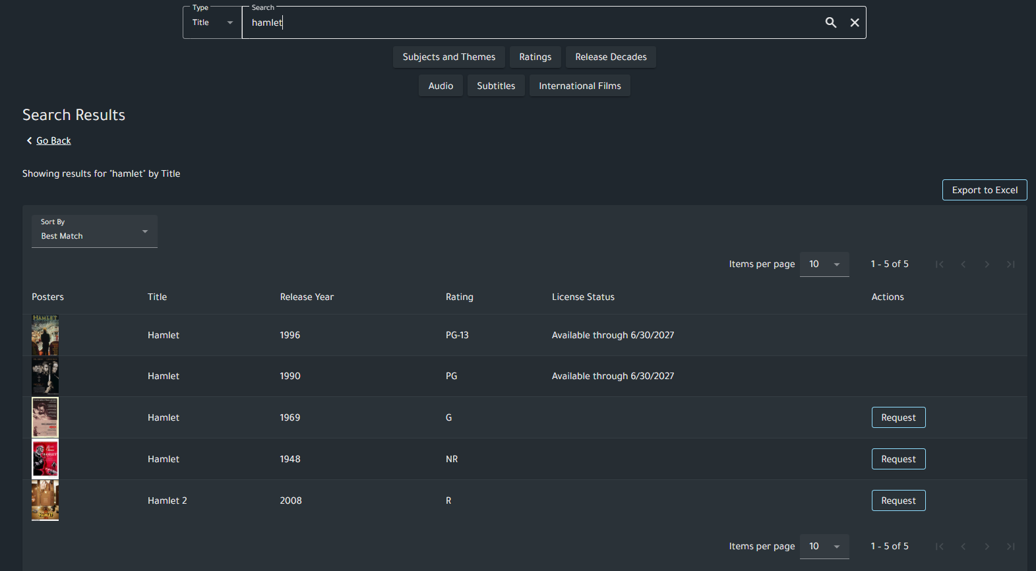
Search Results
Available through:
This indicates that this film is currently available for immediate playback through the date provided.
Request:
This film is available in our library but not currently available for immediate playback by your school. You may request that this film be added to your school’s library of available titles.

Slide 7
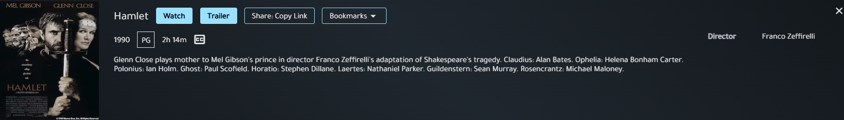
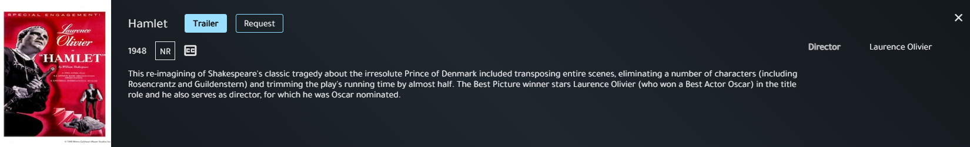
Search Results
If a film is currently licensed, teachers will have the option to play, watch a trailer, copy a share link for students, or create a bookmark:
If a film is not currently licensed, teachers will need to submit a title request for review by your admin team:

Slide 8
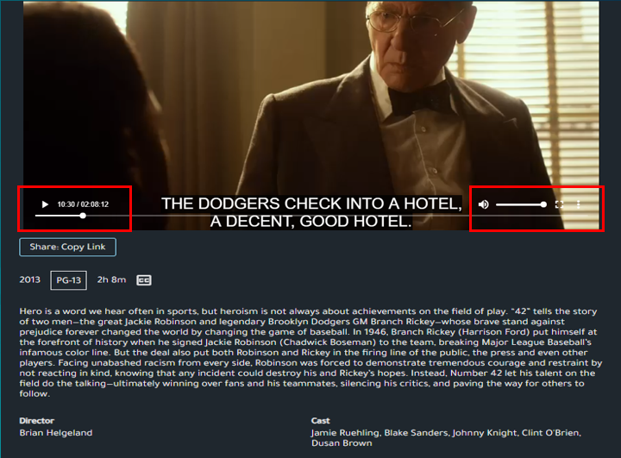
Playing Movies
Use the seek bar to jump to specific parts of a film
The three dot menu icon will give you any additional language options available for a movie as well as Closed Captioning (English Subtitles).
Click on the box next to volume on the bottom right to switch to full screen.

Slide 9
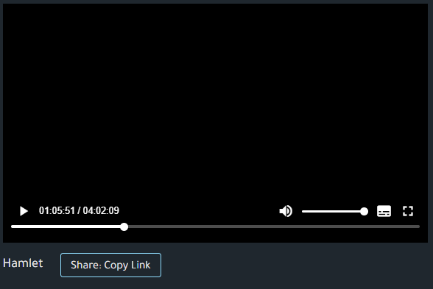
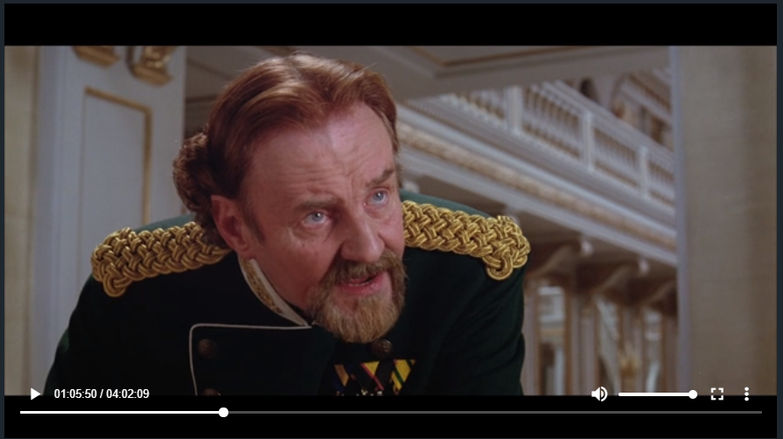
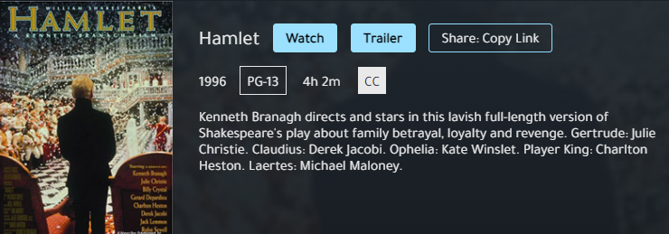
Assigning Movies
To share a currently available film with students, select Share: Copy Link on the movie’s watch page or preview page.
This will copy the full URL to the film, which enables access via any sharing option such as email, course syllabus, and Learning Management Systems.

Slide 10
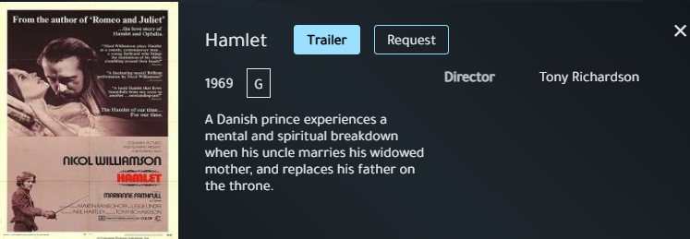
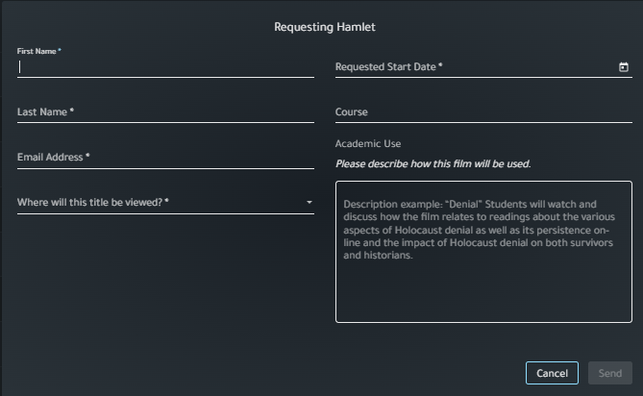
Requesting Movies
Aside from the movies available in your streaming library, your school may request additional titles each year.
After performing any search, films identified with a Request button are those not currently licensed for your school. You can click Request and fill out the form as shown here.
Note: Films requested by an admin user do not require additional approval.

Slide 11
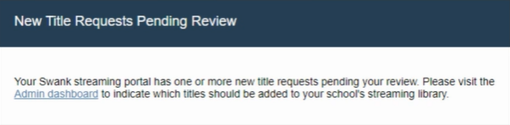
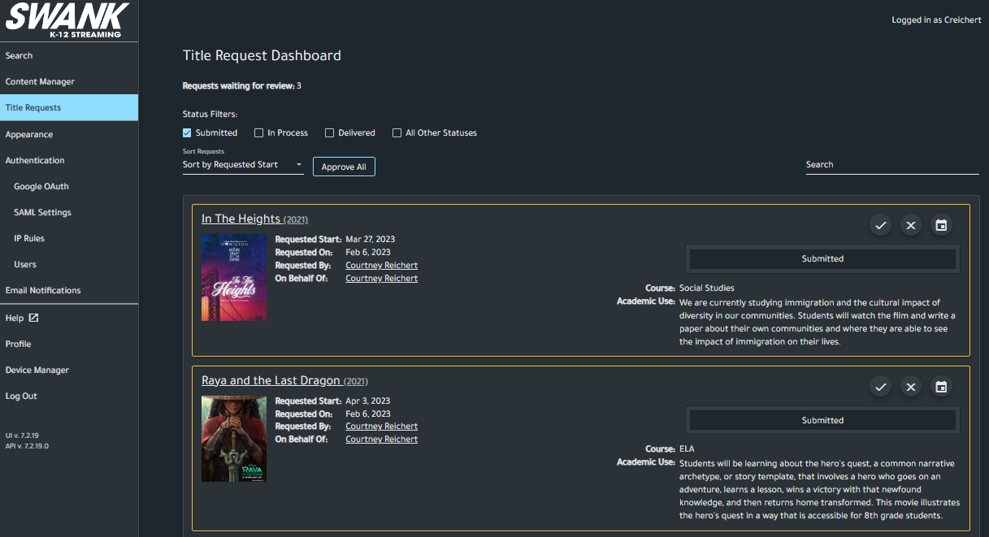
Reviewing Instructor Title Requests
Admin registered to receive ‘Title Request’ email notifications will be notified via email when instructor level users submit a title request. The link in the email will direct you to your Admin Dashboard for review. Once logged in as a Site Administrator, you can select the
Title Requests tab to see the list of pending requests.

Slide 12
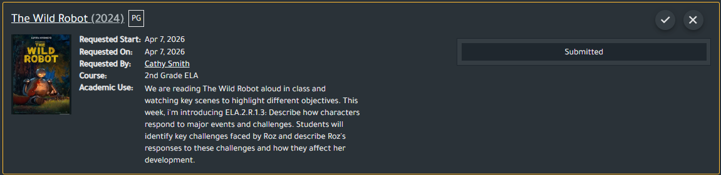
Approving Instructor Title Requests
To approve an individual title, select the checkmark:
Once approved, the request will be processed within one to two business days. The requestor will be notified once the film is live on the platform.

Slide 13
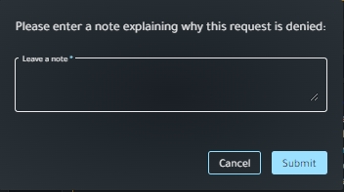
Denying Instructor Title Requests
To deny an individual title, select the X:
You will be prompted to enter a note to your teacher explaining why the request will not be fulfilled and then click “Submit.” The requestor will be notified of the denial.

Slide 14
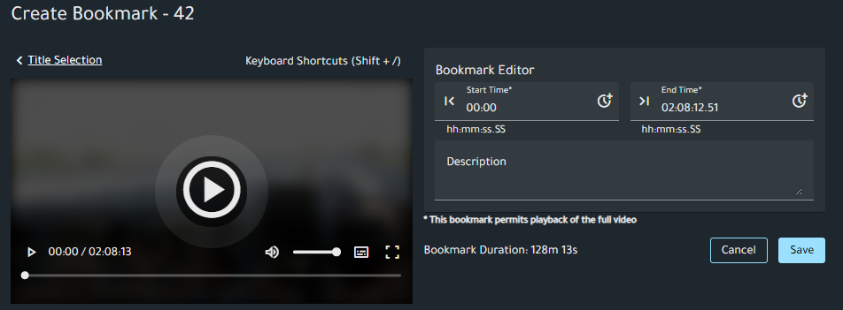
Bookmarks
The bookmark tool allows you to save and annotate key movie segments. You can pre-select the exact scenes you want to use in class, add notes explaining how they connect to your lesson, and create a playlist of the moments most relevant to your teaching goals.
To create a bookmark:
1. Visit the My Bookmarks tab
2. Click Add Bookmark and select the available film.
3. Complete bookmark editor fields and Save.
Once saved, teachers can copy the link for student distribution or select Play to launch the watch screen for your bookmark.

Slide 15
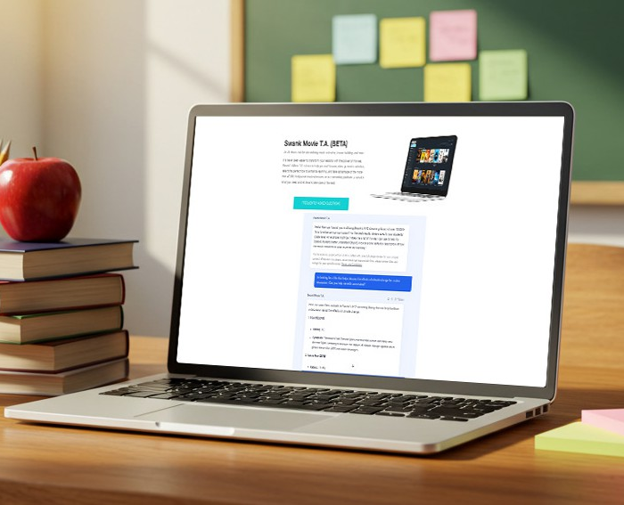
Swank Movie T.A.
Swank’s AI Teaching Assistant is designed to help teachers discover instructional movies, documentaries, and TV programs from the Swank Educational Streaming catalog that support instruction. You can search by:
  Grade Level
  Subject or Unit
  Learning Objective
  Standard
  Theme
  Cross-Curricular Connection
For best results, we recommend teachers include grade level and topic whenever possible!

