Slide 1

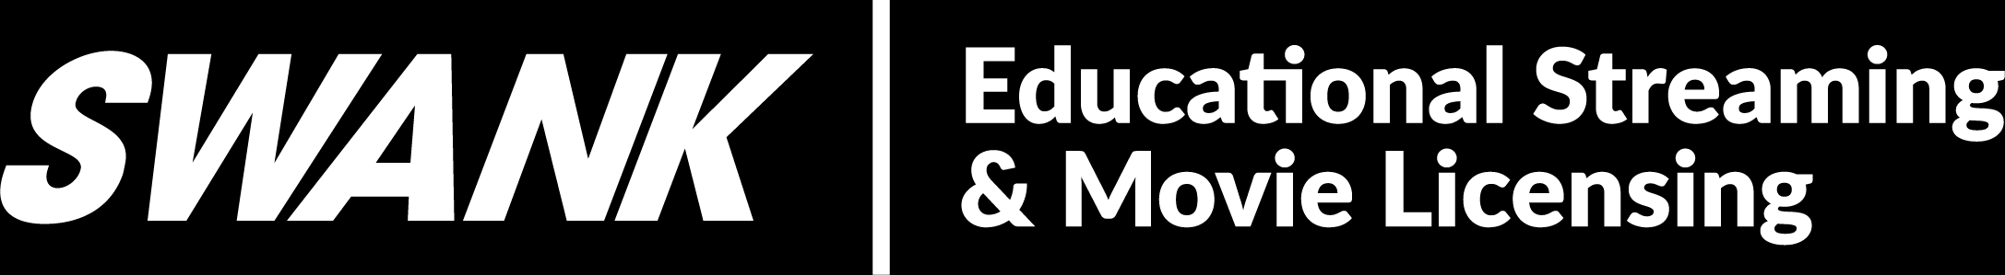
Swank Educational Streaming:
Teacher Guide

Slide 2

Single Sign-On
Access your Swank Educational Streaming portal at the URL provided by your administrator.
If your school is configured for single sign-on, you will automatically be taken to your school’s network log in. Log in using your school network credentials and you will be granted access to the streaming platform.

Slide 3
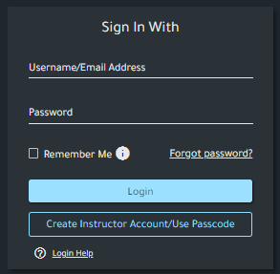
Username/Password
If you are not automatically routed to your school’s network log in, you can enter the username and password provided by your streaming administrator.
If you have not been provided a username and password, please refer to the following page for help creating an account.

Slide 4
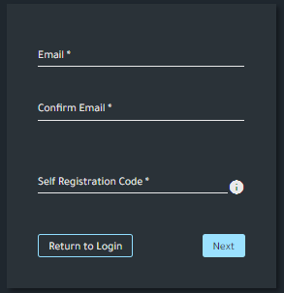
Creating Your Account:
To create an account for the first time, select
‘Create Instructor Account/Use Passcode.’
Your account admin will provide you with a unique passcode, which can be used to register your school email. Once you’ve completed your account profile, a verification email will be sent to your inbox. After you’ve verified your school email, you will be granted access to the Swank Educational Streaming library.

Slide 5
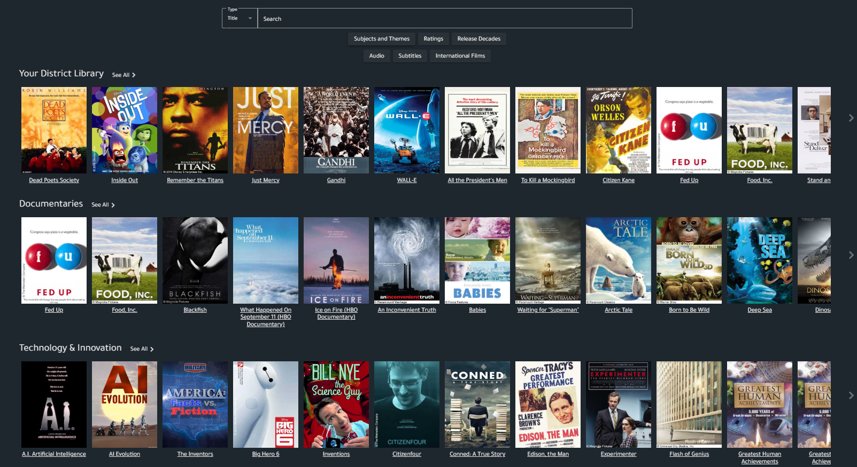
Search & Filter Movies
Search by:
Movie Title
Actor
Director
Filter Your Results By:
Language
Rating
Release Date
Subjects & Themes

Slide 6
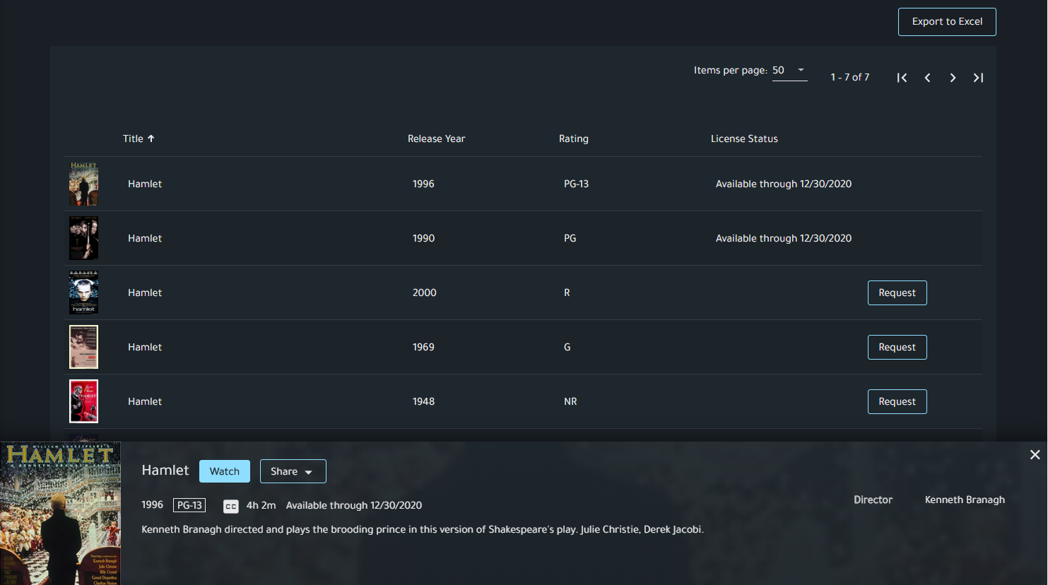
Search Results
Available through:
This indicates that this film is currently available for immediate playback through the date provided.
Request:
This film is available in our library but not currently available for immediate playback by your school. You may request that this film be added to your school’s library of available titles.

Slide 7
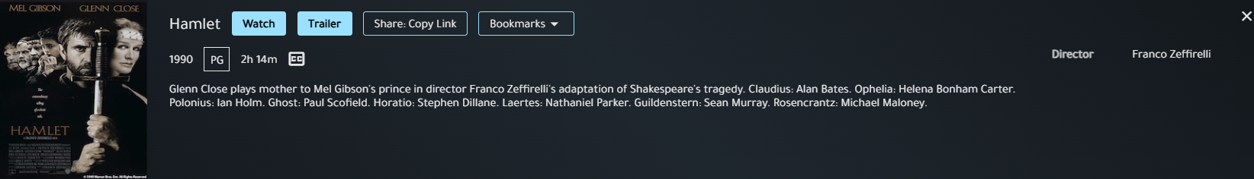
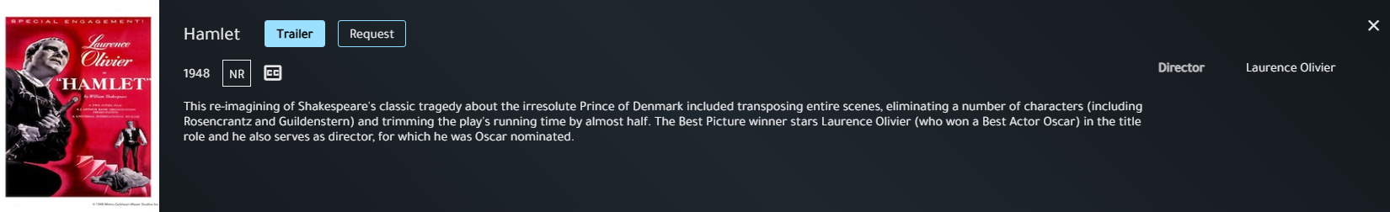
Search Results
If a film is currently licensed, you will have the option to play the title, watch a trailer, copy a share link for students, or create a bookmark:
If a film is not currently licensed, you will need to submit a title request for review by your admin team:

Slide 8
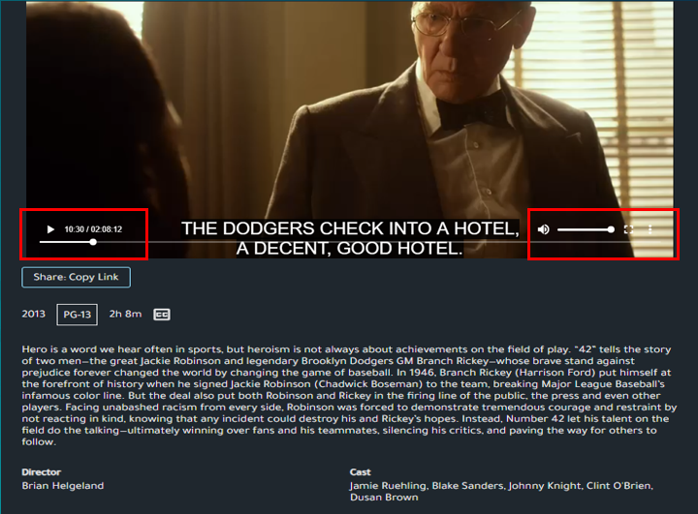
Playing Movies
Use the seek bar to jump to specific parts of a film
The three dot menu icon will give you any additional language options available for a movie as well as Closed Captioning (English Subtitles).
Click on the box next to volume on the bottom right to switch to full screen.

Slide 9
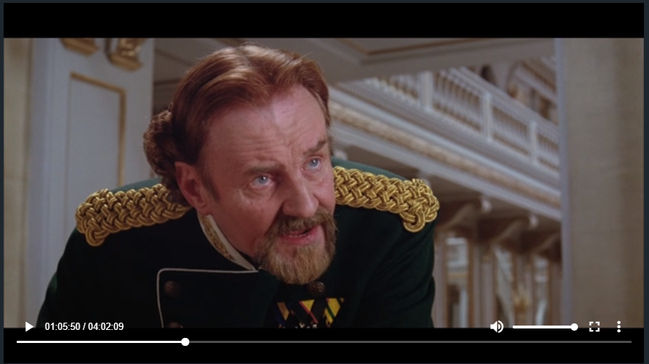
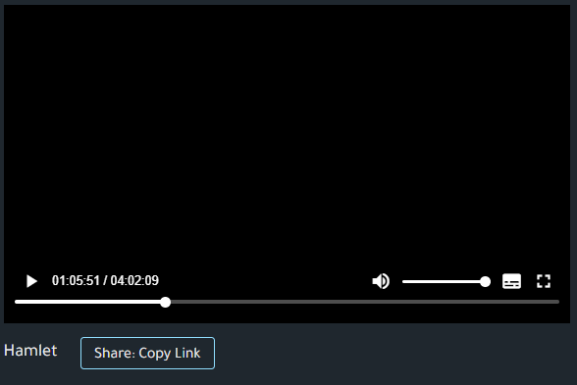
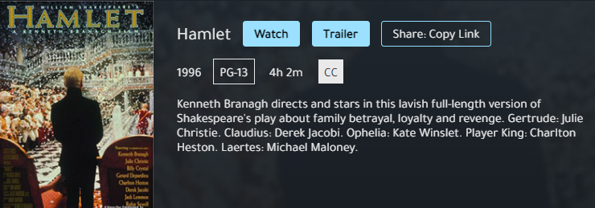
Assigning Movies
To share a currently available film with students, select Share: Copy Link on the movie’s watch page or preview page.
This will copy the full URL to the film, which enables access via any sharing option such as email, course syllabus, and Learning Management Systems.
Your school’s portal admin will provide additional information on how students will authenticate.

Slide 10
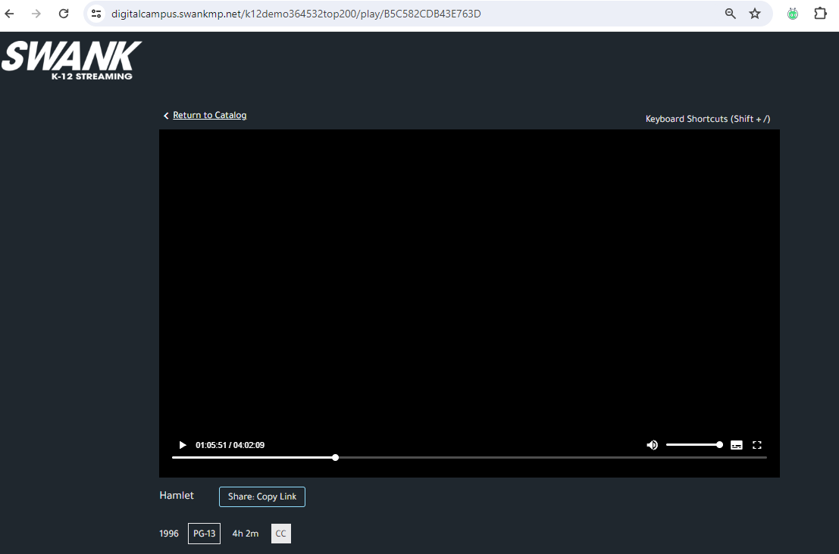
Assigning Movies
It is important to note that students DO NOT have the ability to see the entire library of films as you do. Students will only see films they have been assigned by providing them with the Share: Copy Link.
Providing students the main page navigation URL will result in them receiving an error message.

Slide 11
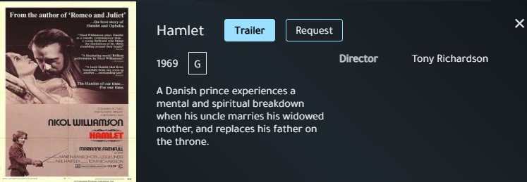
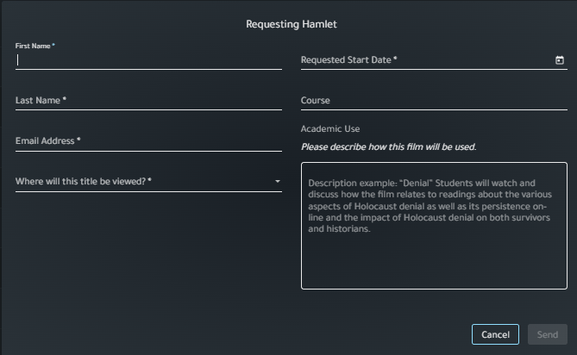
Requesting Movies
Aside from the movies available in your streaming library, your school may request additional titles each year.
After performing any search, films marked with a Request button are those not currently licensed for your school. You can click Request and fill out the form as shown here.
Note: Once approved by your admin, requested films are typically available in your streaming library within two business days and will remain available through the duration of your school's Swank streaming contract.

Slide 12
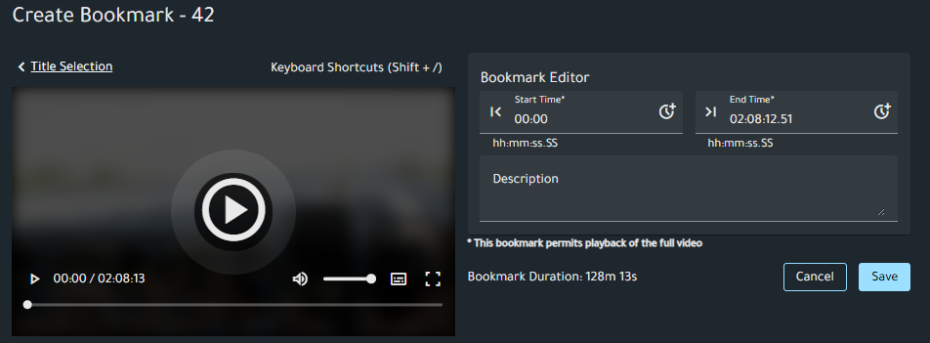
Bookmarks
The bookmark tool allows you to save and annotate key movie segments. You can pre-select the exact scenes you want to use in class, add notes explaining how they connect to your lesson, and create a playlist of the moments most relevant to your teaching goals.
To create a bookmark:
1. Visit the My Bookmarks tab
2. Click Add Bookmark and select the available film.
3. Complete bookmark editor fields and Save.
Once saved, you can copy the link for student distribution or select Play to launch the watch screen for your bookmark.

Slide 13
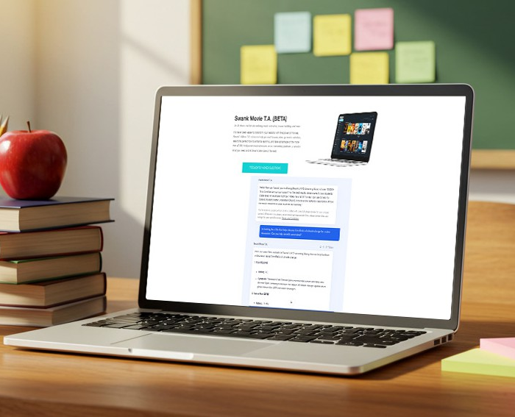
Swank Movie T.A.
Swank’s AI Teaching Assistant is designed to help teachers discover instructional movies, documentaries, and TV programs from the Swank Educational Streaming catalog that support instruction. You can search by:
  Grade Level
  Subject or Unit
  Learning Objective
  Standard
  Theme
  Cross-Curricular Connection
For best results, we recommend including grade level and topic whenever possible!

