Slide 1



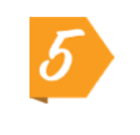
School Year Launch Guide
A note to admin:
We want to make sure your school gets the maximum value out of the platform and that teachers can easily access it throughout the year. Below, we’ve outlined updates you can make as the administrator. Then, the following pages are designed to be shared with your staff to ensure they are familiar with the platform.
Let’s get started!
Add the designated school or district administrator to the “Welcome to Swank K-12 Streaming” page. Make sure this contact is also the recipient of Title Request Email Notifications within your platform.
Teacher registration codes expire after one year, so you must create a new one each school year to ensure new teachers can create accounts without interruption.
From your admin dashboard, select Authentication in the left-hand menu
Under Instructor Self Registration, click Create New Registration Code
Toggle Unlimited Uses, then click Create
Paste the new code into Step 2 of the “Setting Up Your Account” page in this packet
Add your school’s streaming portal URL to the page titled “Welcome to Swank K-12 Streaming.”
Note: This is the same site URL used each year, but it can also be copied from the “Instructor Self Registration” section in the “Authentication” tab.
Add your school’s student login credentials to the “Assigning Movies to Students” page. You can manage these under “Users” within your Admin portal. To edit, choose “Edit Profile and Password” from the dropdown menu next to a username.
Send this guide to your teachers to ensure everyone is familiar with using the Swank K-12 Streaming platform.

Slide 2

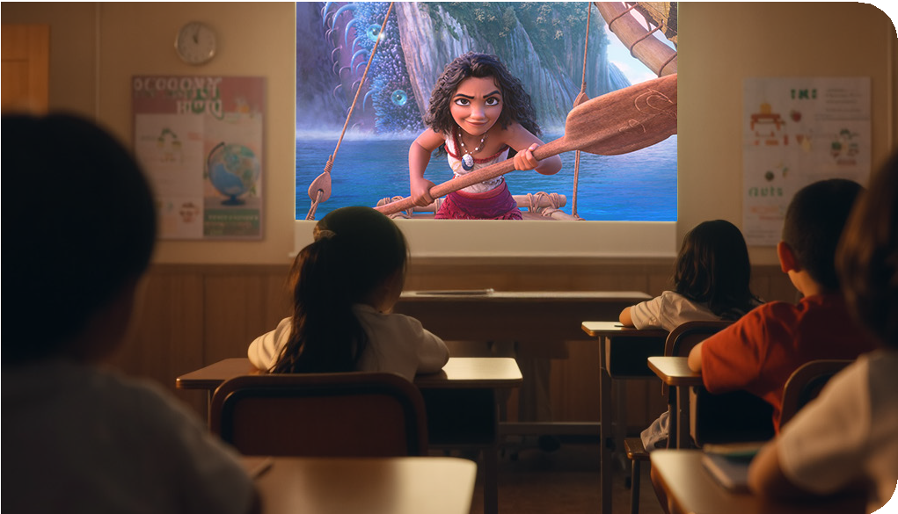


Swank Educational Streaming
Welcome to
Your school has access to a library of more than 45,000 movies, documentaries and foreign language films to support instruction through the Swank Educational Streaming library.
You now have access to a curated collection of top, educational films which are click-and-play ready in your streaming library. You are also able to search the entire library of films and request for new films be added. These requests will either be approved or denied by your school’s Administrator:
[Insert Administrator Name/Email]
The administrator can also help with questions and
[Insert Streaming Link]
Bookmark this site for future access.
(Please note, this website URL should not be shared with students.)

Slide 3


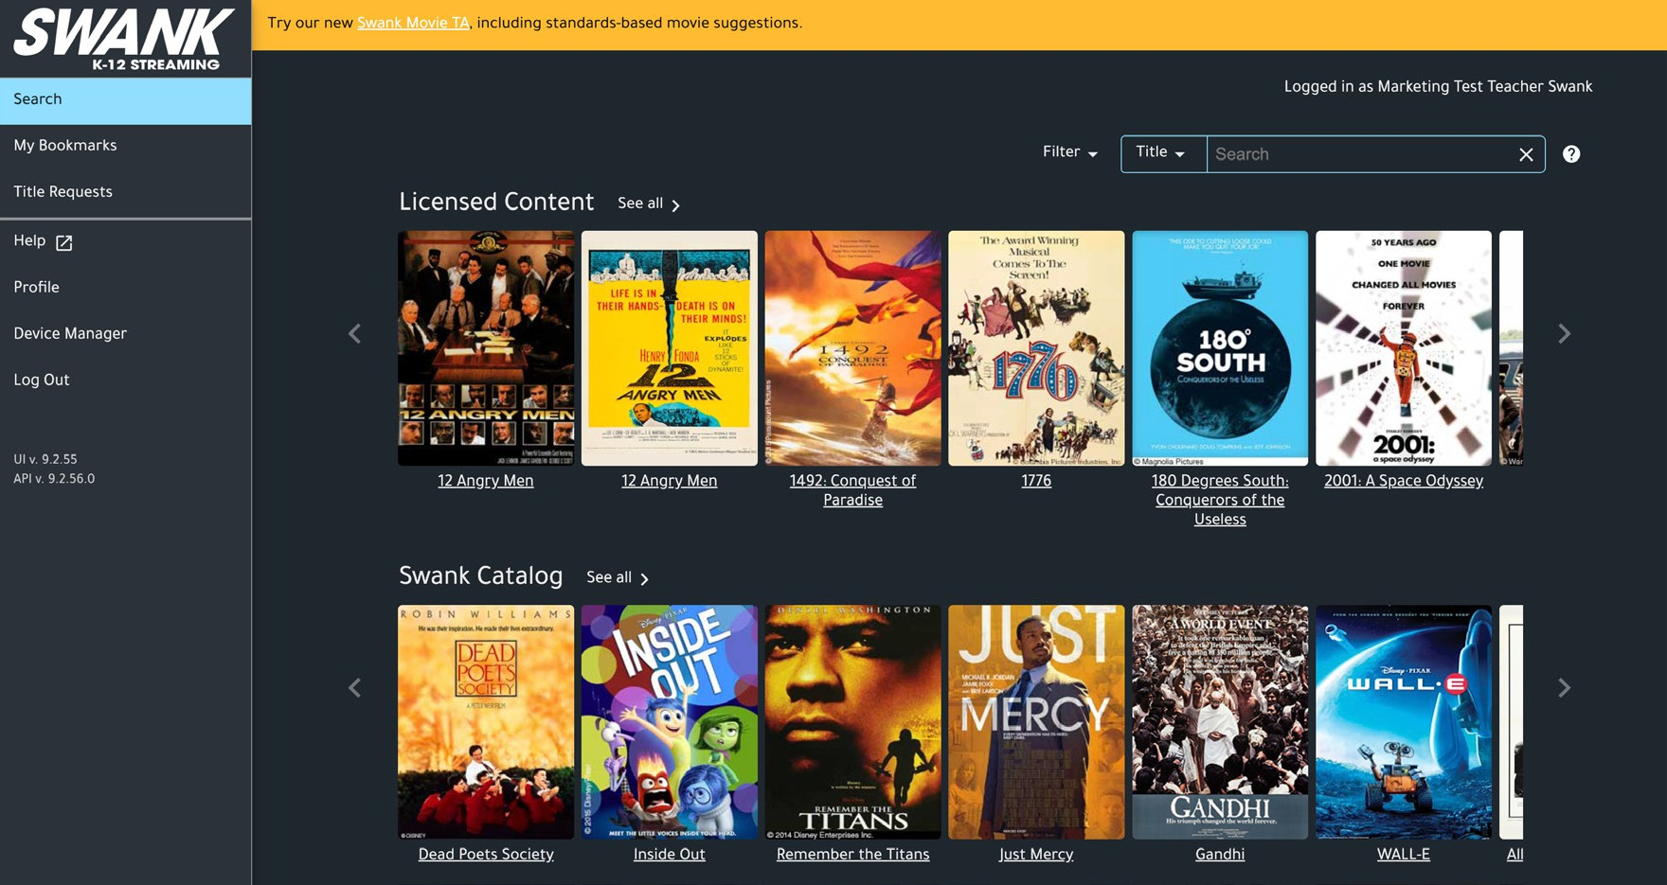
Setting Up Your Account
Visit the streaming portal and click “Create Instructor Account”
Register using your school email and this Self Registration Code: (COPY CODE HERE)
If you receive an invalid email error, confirm you’re using your school email. If issues persist, contact your admin to update allowed domains.
Fill out your profile and click “Register”
Verify your email by clicking the confirmation link sent to your inbox. Please check your spam/junk folder if you do not see an email in your inbox.
You’ll be redirected to the film library. If not, return to the portal URL to log in.

Slide 4

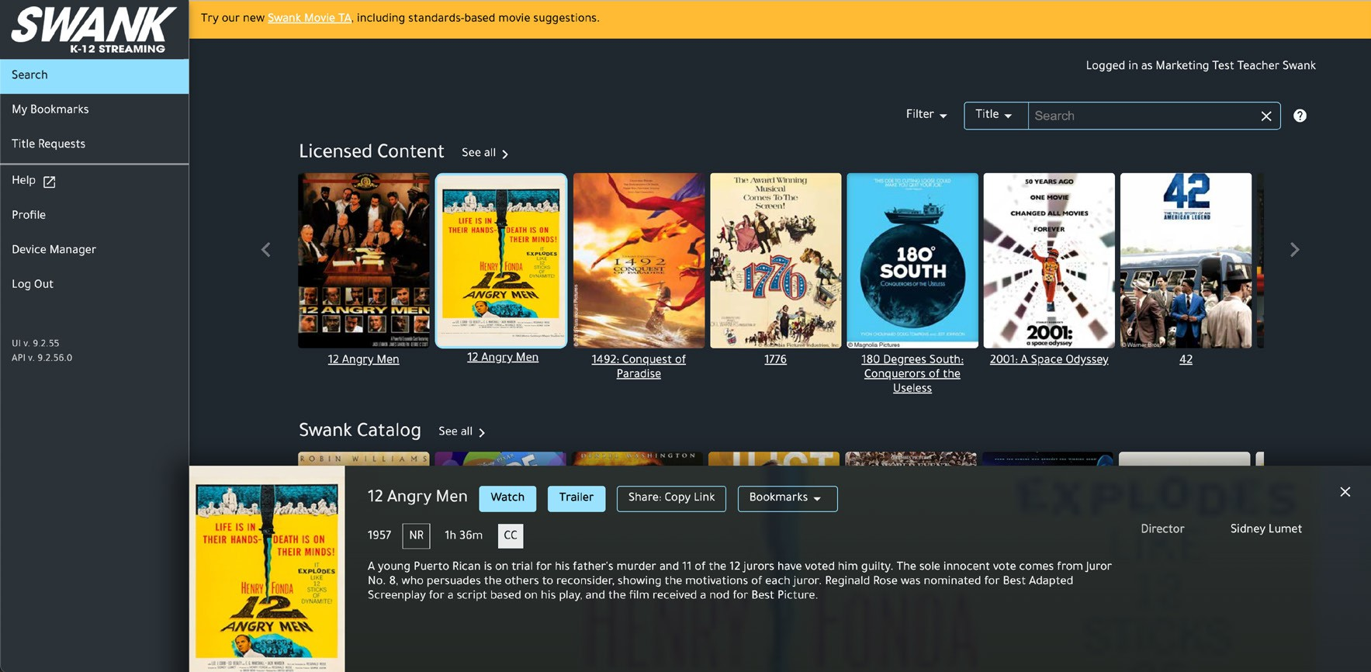
Sharing Films With Students
Student Username:
Student Password:
Search for your film.
Confirm it’s available in the library.
“Watch” and “Share: Copy Link” buttons = ready to use
“Request” = submit request for admin approval prior to assigning the film
Is the share copy link not available on the film you need? See the next page for how to make a request!
Click “Share: Copy Link”
Only share this generated link with students. Do not copy the browser URL – it won’t work for them.
Paste the link into your classroom platform.
Students log in using existing school credentials. Never share your teacher login information with students as you have different permissions
than they do.

Slide 5

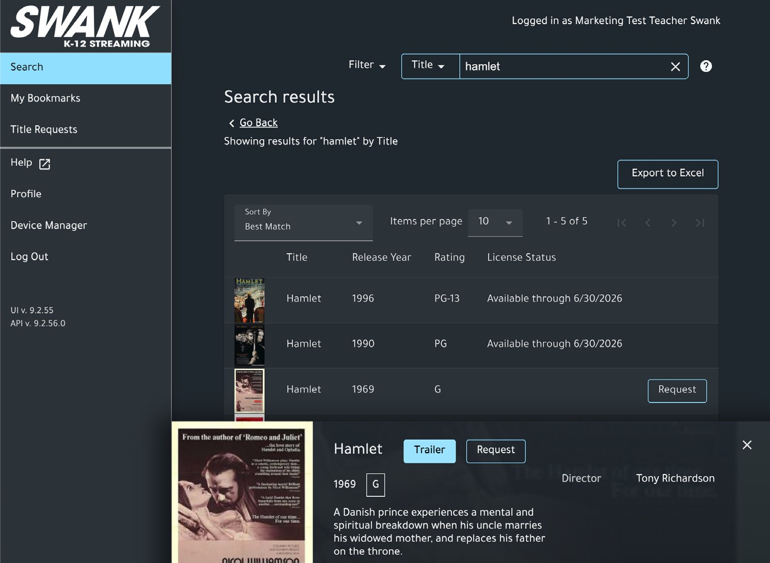



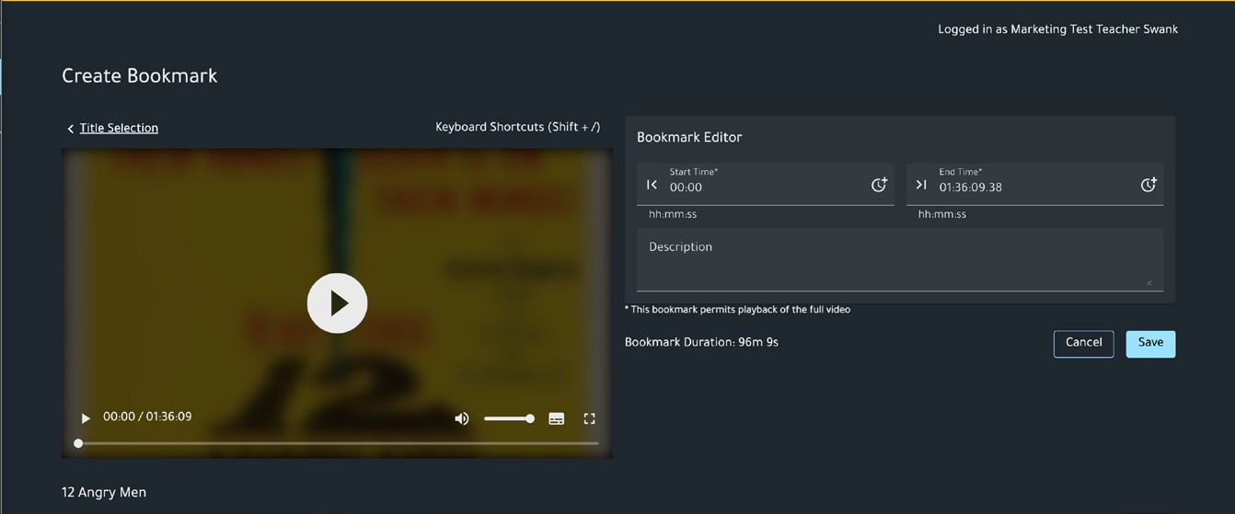




Requesting Additional Films
Search for the film you want.
Click “Request.”
Fill out the request form and click “Send.”
Your title request will be sent to your portal administrator for review.
Bookmarks
Use Bookmarks to Focus on Key Segments
Swank Educational Streaming’s built-in bookmark tool will save and annotate key movie segments. Pre-select the exact scenes you want to use in your class, add notes about how they tie into your lesson, and build a playlist of the moments most relevant to the teaching goals.
Visit the “My Bookmarks” tab on your portal dashboard. Click “Add Bookmark” and select the available film.
Complete Bookmark Editor fields and save.
Once saved, you can copy the link for student distribution or select “Play” to launch the watch screen for your bookmark.

Slide 6
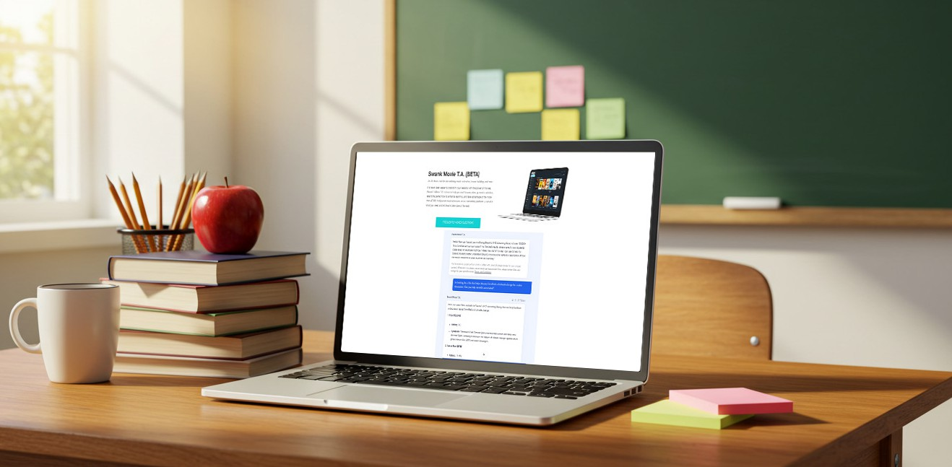
Swank Movie T.A.
Swank Movie Teaching Assistant, Here to Help
Need help finding a film that aligns with a specific standard or learning objective? Just ask Swank’s new AI Teaching Assistant for movie suggestions based on a particular standard, curriculum, lesson goals, grade level, subject matter, etc.
swank.com/swank-movie-ta
Helpful Resources
Explore training videos, admin/teacher guides, and platform walkthroughs:
K-12 Streaming Resource Hub:
swank.com/k-12-streaming/resources-landing-page/
Help Center:
swankmp.clickhelp.co/articles/help-portal-k-12

