Slide 1









School Year Launch Guide
A note to admin:
We want to make sure your school gets the maximum value out of the platform and that teachers can easily access it throughout the year. Below, we’ve outlined updates you can make as the administrator. Then, the following pages are designed to be shared with your staff to ensure they are familiar with the platform.
Let’s get started!
Add the designated school or district administrator to the “Welcome to Swank K-12 Streaming” page. Make sure this contact is also the recipient of Title Request Email Notifications within your platform.
Add your school’s unique streaming portal URL to the same page. (Provided in your kickoff packet/email.)
Distribute this “Welcome to Swank K-12 Streaming” packet to your teachers. Your portal uses Single Sign-On – teachers and students simply log in with their existing school credentials.

Slide 2

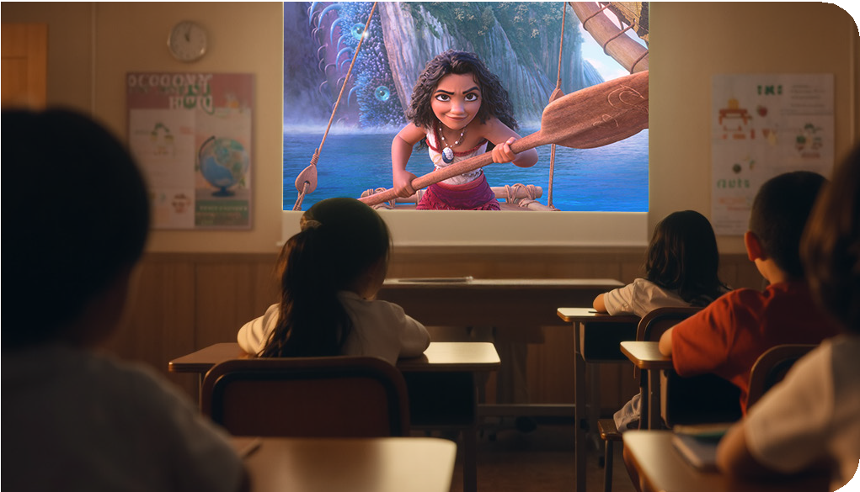


Welcome to
Swank Educational Streaming
Your school has access to a library of more than 45,000 movies, documentaries and foreign language films to support instruction through the Swank Educational Streaming library.
You now have access to a curated collection of top, educational films which are click-and-play ready in your streaming library. You are also able to search the entire library of films and request for new films be added. These requests will either be approved or denied by your school’s Administrator:
[Insert Administrator Name/Email]
The administrator can also help with questions and challenges related to the platform.
[Insert Streaming Link]
Bookmark this site for future access.
Sign in with your school or district credentials.
(Please note, this website URL should not be shared with students.)

Slide 3


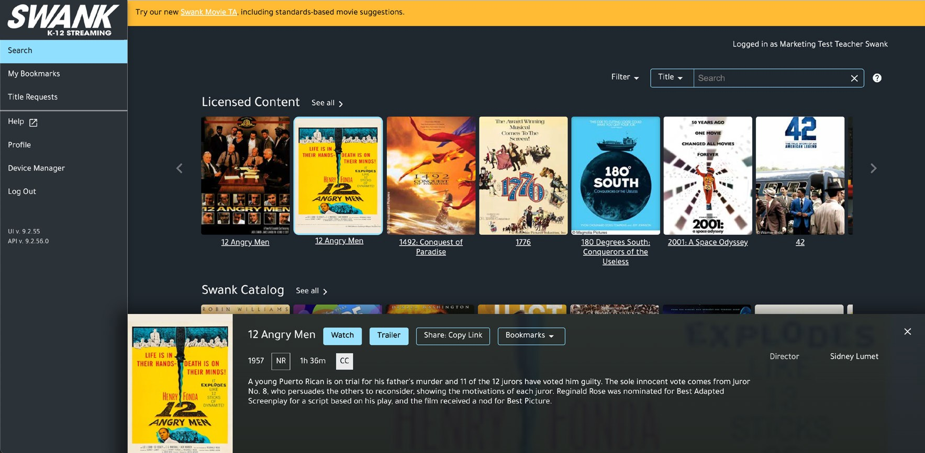

Sharing Films With Students
Search for your film.
Confirm it’s available in the library.
“Watch” and “Share: Copy Link” buttons = ready to use
“Request” = submit request for admin approval prior to assigning the film
Is the share copy link not available on the film you need? See the next page for how to make a request!
Click “Share: Copy Link”
Only share this generated link with students. Do not copy the browser URL – it won’t work for them.
Paste the link into your classroom platform.
Students log in using existing school credentials. Never share your teacher login information with students as you have different permissions
than they do.

Slide 4

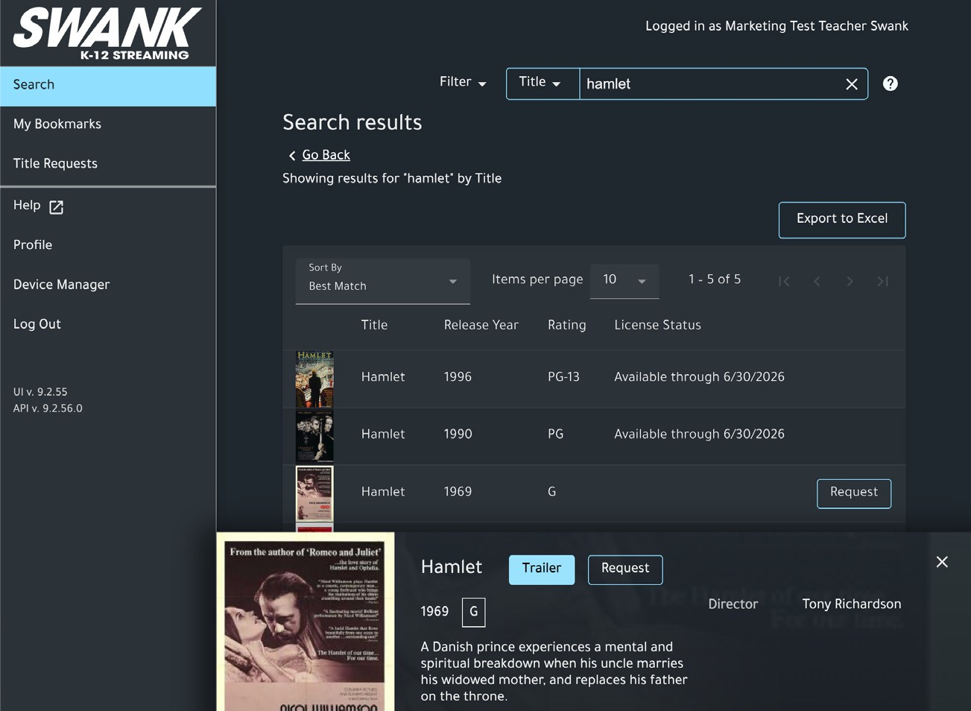



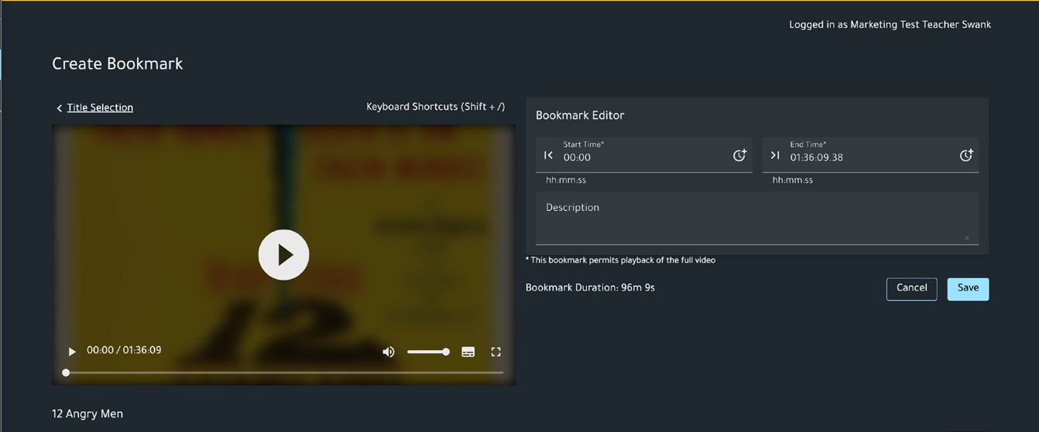




Requesting Additional Films
Search for the film you want.
Click “Request.”
Fill out the request form and click “Send.”
Your title request will be sent to your portal administrator for review.
Bookmarks
Use Bookmarks to Focus on Key Segments
Swank Educational Streaming’s built-in bookmark tool will save and annotate key movie segments. Pre-select the exact scenes you want to use in your class, add notes about how they tie into your lesson, and build a playlist of the moments most relevant to the teaching goals.
Visit the “My Bookmarks” tab on your portal dashboard. Click “Add Bookmark” and select the available film.
Complete Bookmark Editor fields and save.
Once saved, you can copy the link for student distribution or select “Play” to launch the watch screen for your bookmark.

Slide 5
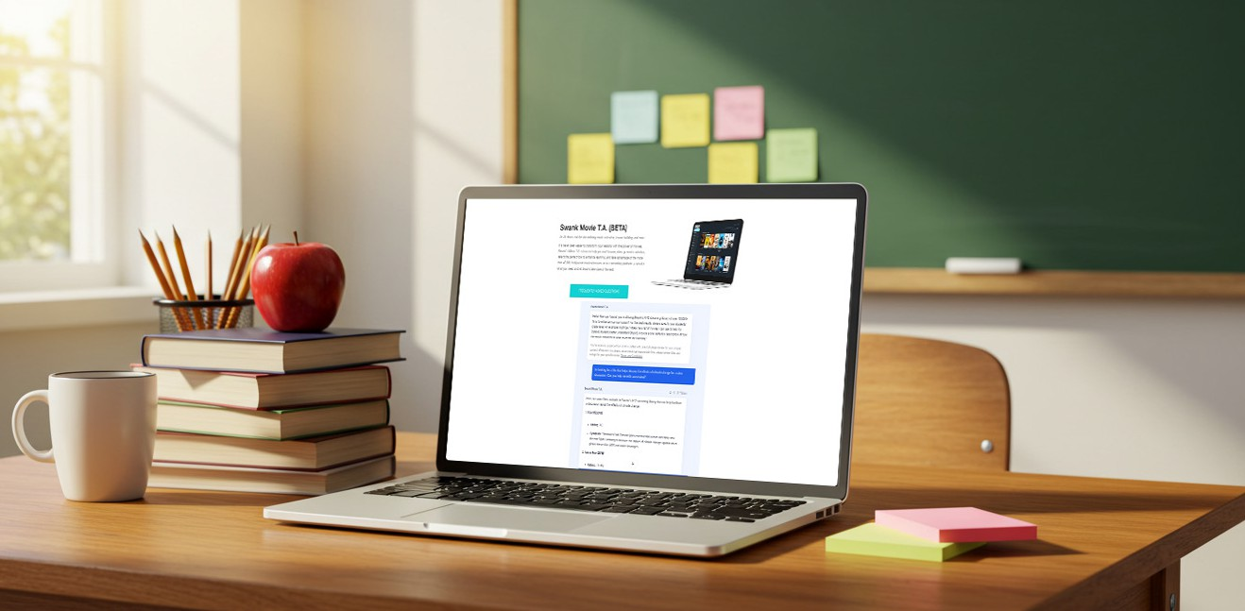
Swank Movie T.A.
Swank Movie Teaching Assistant, Here to Help
Need help finding a film that aligns with a specific standard or learning objective? Just ask Swank’s new AI Teaching Assistant for movie suggestions based on a particular standard, curriculum, lesson goals, grade level, subject matter, etc.
swank.com/swank-movie-ta
Helpful Resources
Explore training videos, admin/teacher guides, and platform walkthroughs:
K-12 Streaming Resource Hub:
swank.com/k-12-streaming/resources-landing-page/
Help Center:
swankmp.clickhelp.co/articles/help-portal-k-12

